Slide 1
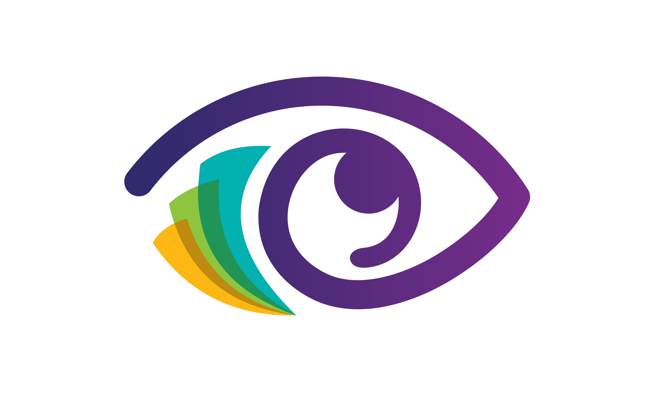
Hello teachers,
I come to you to discuss a matter of grave pediatric public health significance that presents itself at school. And you as educators have the power to change its course.
MyEyesMyLife.org
Where we high-schoolers go back to our preschools or elementary schools to remind teachers of the important role they play as a first line of defense in the war against childhood myopia (nearsightedness/difficulty seeing afar)
MyEyesMyLife.org

Slide 2
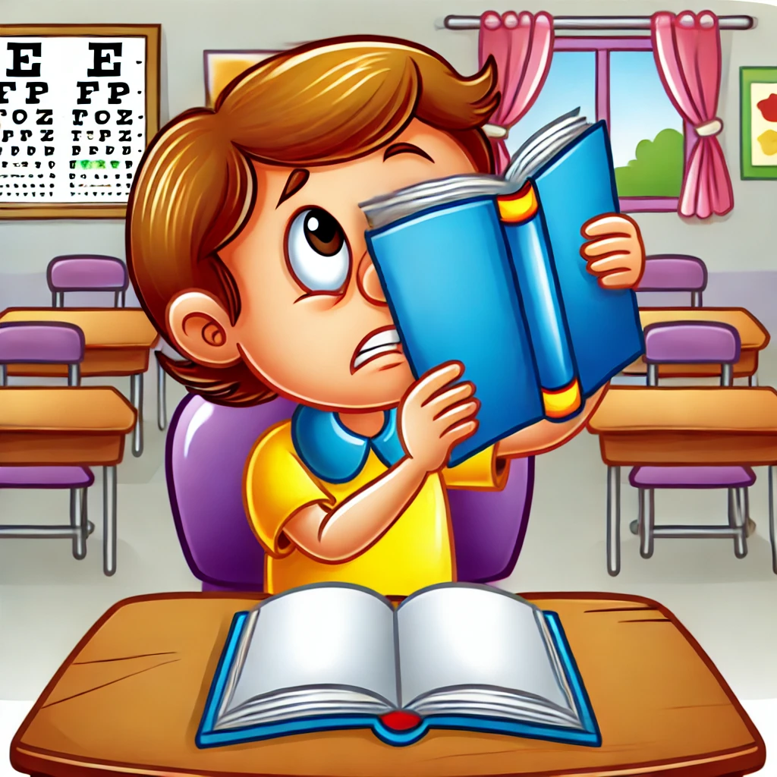
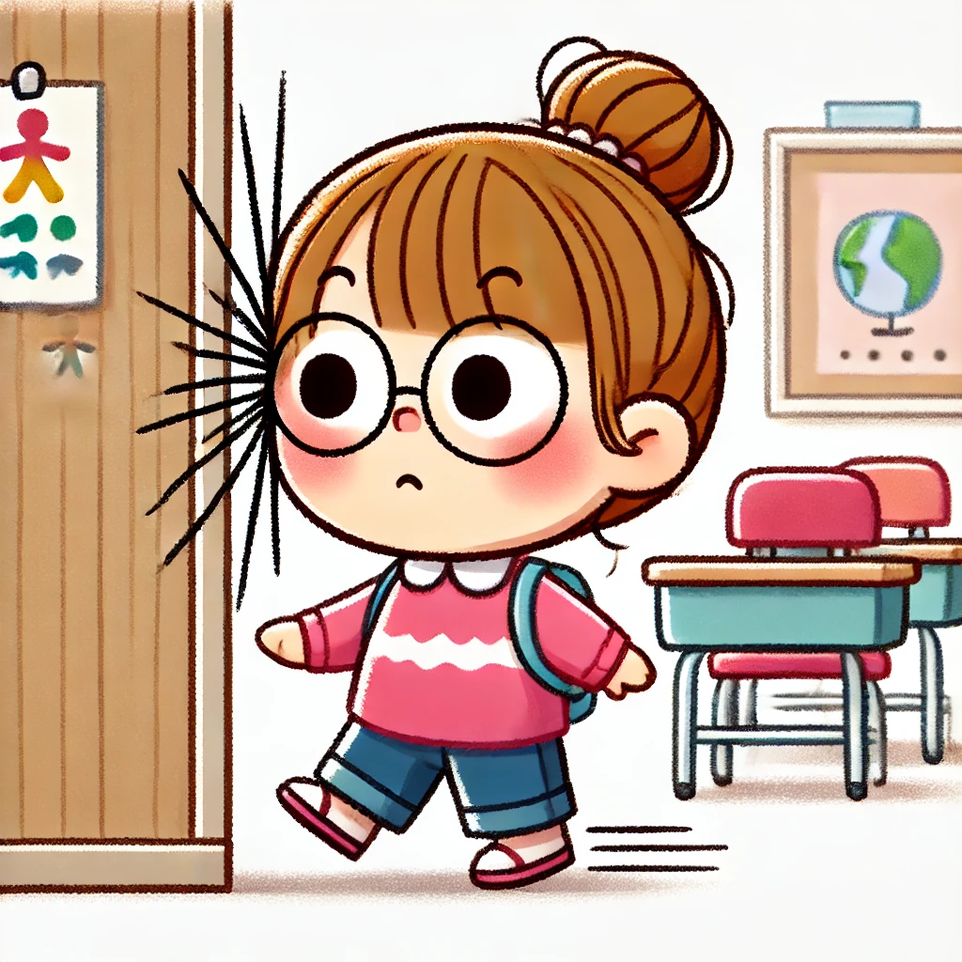
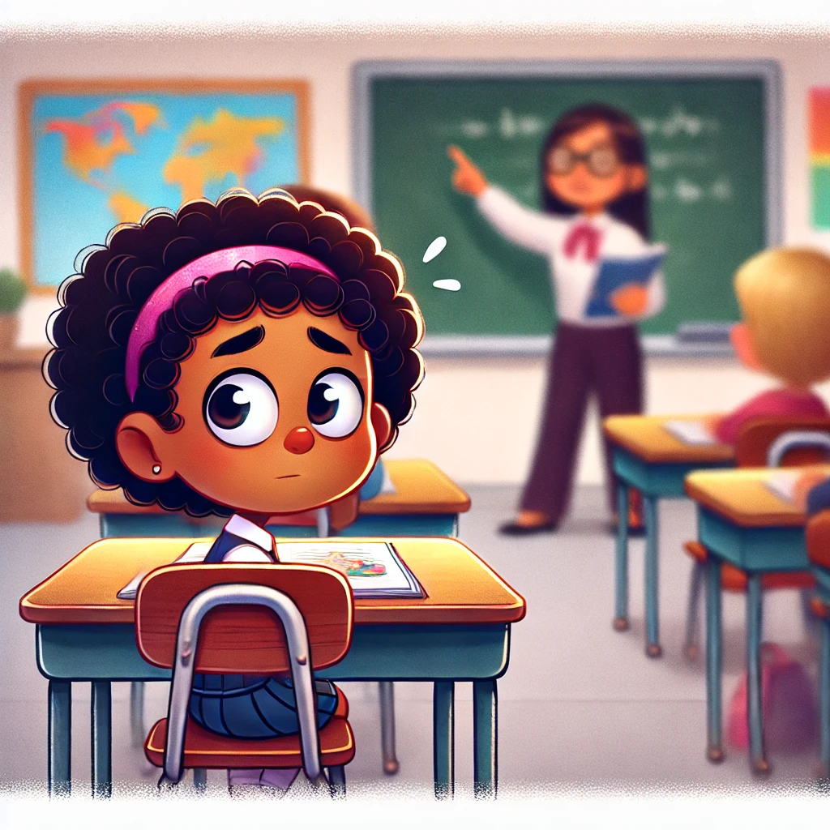
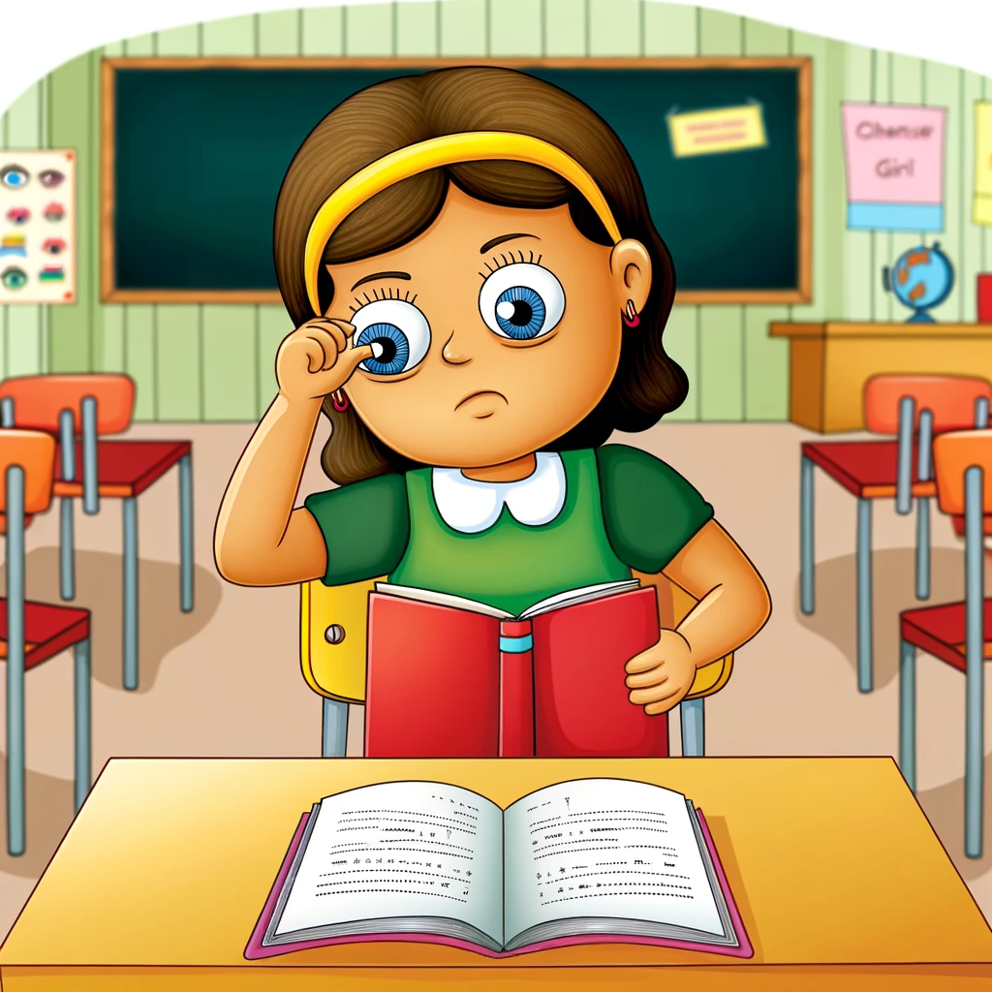
Have You Seen This Student In Your Class?
The one who brings the book
up right to their face to read
The one who keeps bumping her/his head against surfaces
The one who freaks out when he/she has to answer about something written on the board
The one rubs their eyes incessantly while reading
MyEyesMyLife.org

Slide 3
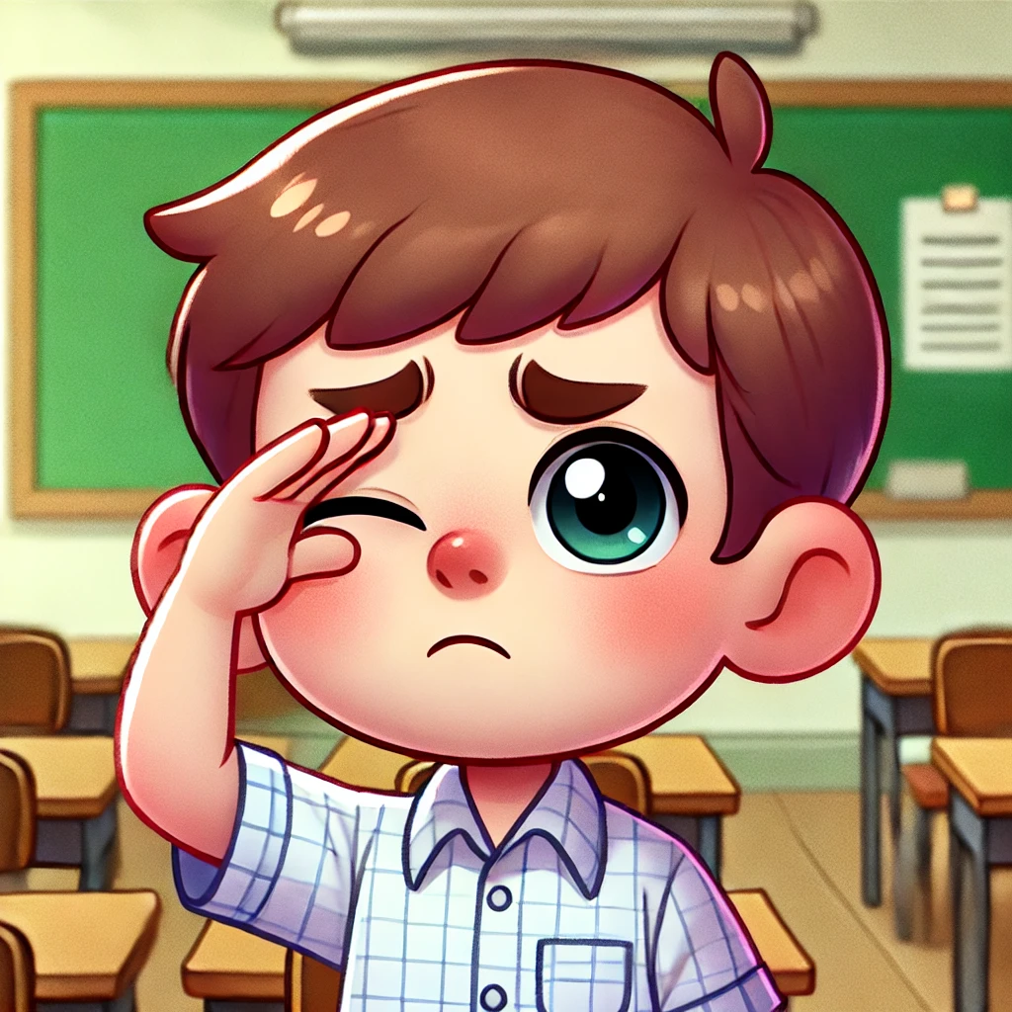
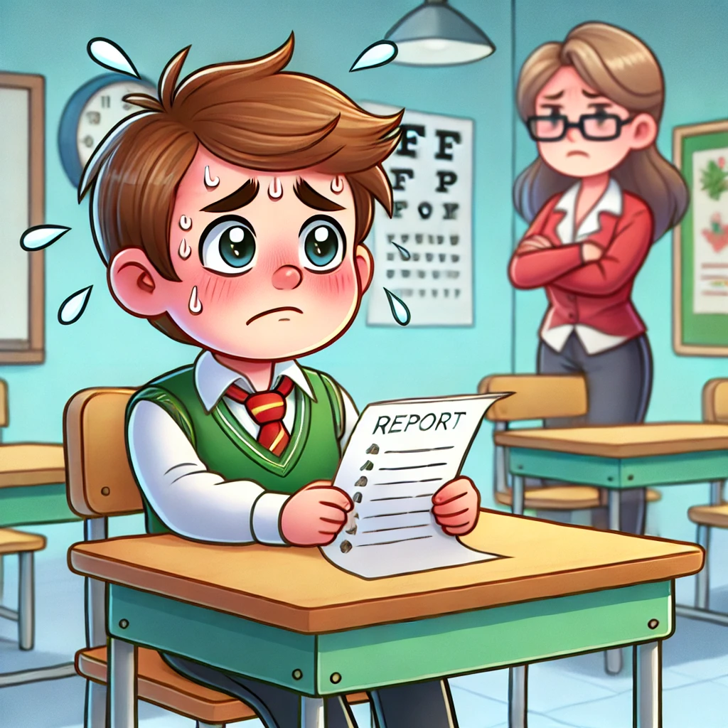
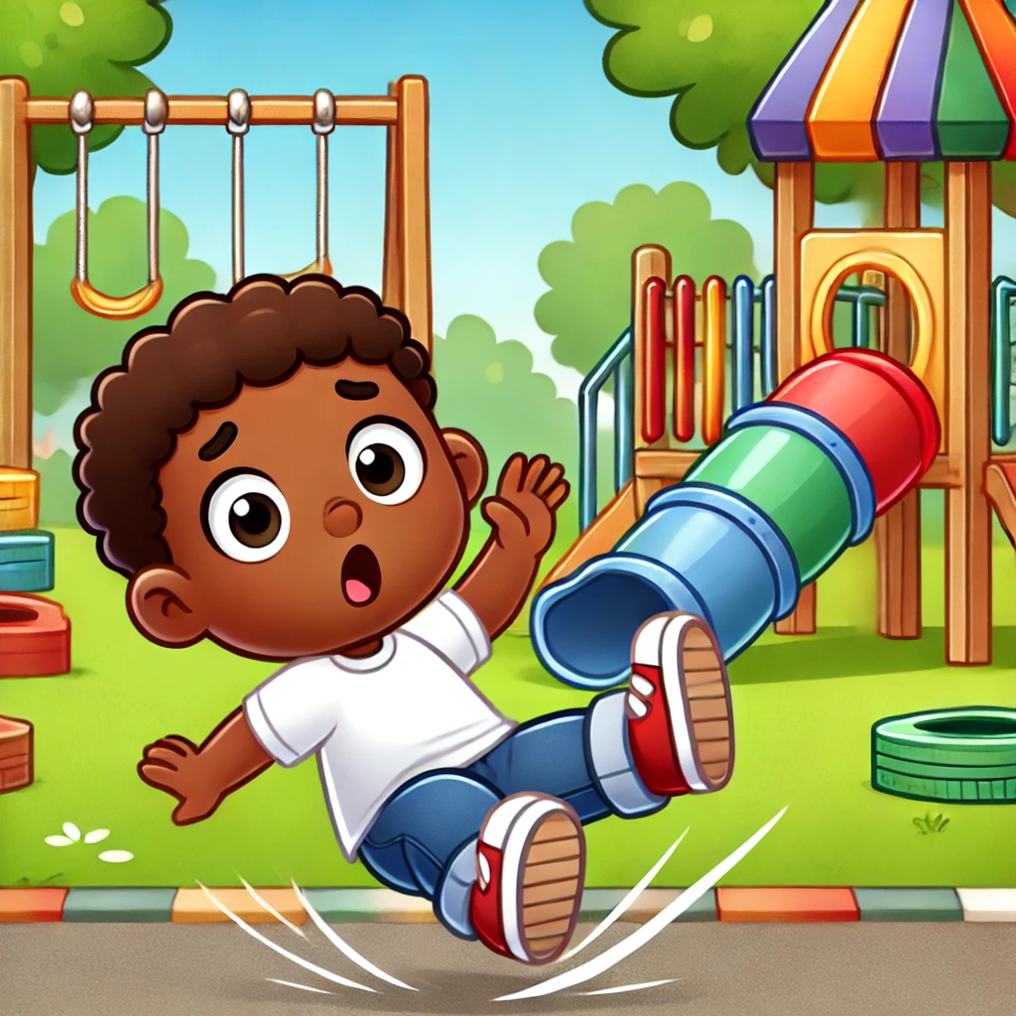
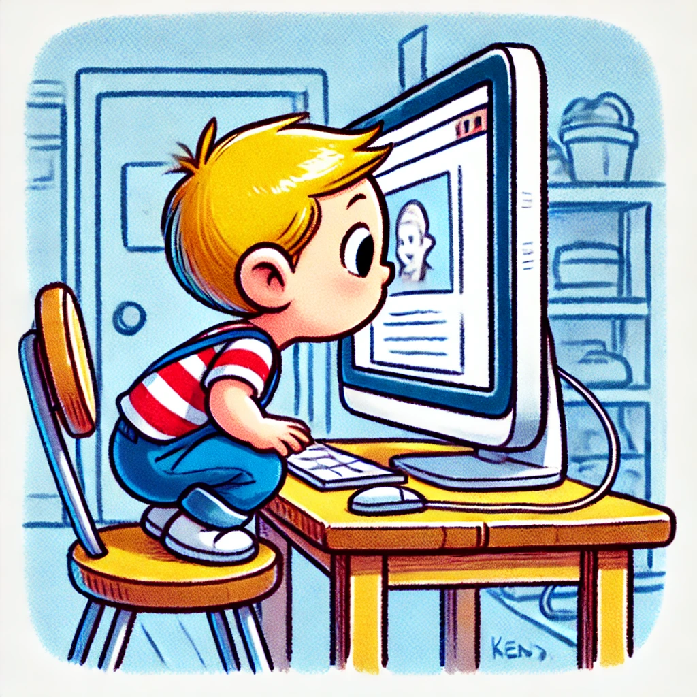
What About this Student?
The one who keeps having to close one eye/squint to read the board
The one whose grades seem to be dropping for no explainable reason
The one who keeps tripping and falling during PE despite there being no obstacles
The one who literally puts their face into the computer screen while reading
MyEyesMyLife.org

Slide 4
Idiosyncrasies of Toddlers or Something Else?
As a teacher you may think of these strange behaviors as silliness and idiosyncrasies of small children
but what if it is a symptom of a disorder?
Today I want to talk to you about what can be one common but debilitating disorder that can lead to all of these symptoms: Myopia or Nearsightedness.
Simply put, myopia is a disorder of the lens of our eyes that makes it difficult for us to see afar. We continue to see objects close to us just as well as we always did, but distant things seem out of focus or blurry (or in the worst case, not there at all)—such a person is “nearsighted”
The simple way to compensate for this blurriness of distant objects is by bringing a book closer to the eyes or getting our head closer to the computer screen.
MyEyesMyLife.org

Slide 5
To Understand Myopia One First Needs to Know How our Eyes Work
Biology of the normal eye: The cornea of a normal eye is shaped in such a way that the light emitted from an object (near or far) can be taken by the eye lens and made to converge at the retina and form a sharp image right on the retinal tissue.
Biology of myopic eyes: The cornea of a myopic eye starts to elongate in such a way that it bulges outwards and its distance from the retina increases. Now, when the light emitted from an object enters through the eye lens, it can no longer be converged on the retina but rather in front of the retina, in the fluid of the vitreous humor.
See image: the kids in front appear sharp, but the adults afar
are blurry
MyEyesMyLife.org

Slide 6
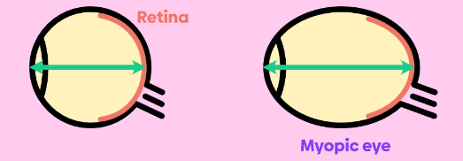
Why Are We So Focused on Small Children?
Myopia strikes little children first! The onset of this disorder is the highest in children between 5-10 years of age
In our ultra digital era the age range is now children 3-10 years old
This is because just as little children are growing and all their body parts are getting bigger, so does their cornea. Sometimes this corneal growth exceeds the normal rate resulting in myopia
In myopic children, as the cornea grows with age, it keeps bulging outwards, increasing its distance from the retina
Therefore, myopia is a progressive disorder and as the child (and their cornea) keeps growing (between age 3 and 10 years), myopia worsens rapidly
Between age 13-25 years the rate of progression is still high but somewhat slower
After 25 years of age, myopia is known to finally plateau—but the harm is already done in the childhood
As the cornea bulges outwards in myopia, the distance in the front and back of the eye (axial length; AL) increases, making it more difficult for the eye lens to focus images sharply on the retina
AL= 23 mm
AL >24 mm
Normal Eye
MyEyesMyLife.org

Slide 7
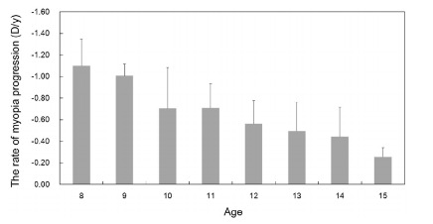
The Math Disastrous Consequences?
Assume a 7-year-old child (2nd grade) has a -1.0D equivalent vision loss that is uncorrected
Using the graph below, their prescription at:
Age 8 = -1.0 (at outset) + (-1.1 D/year)= -2.1D
Age 9= -2.1 + (-1.0 D/year) = -3.1D
Age 10 = -3.1D+ (-0.7 D/year) = -3.8D
Age 11 = -3.8D + (-0.7 D/year) = -4.5D
Age 12 = -4.5D + (-0.5D/year) = -5.0D
Age 13 = -5.0D + (-0.45D/year) = -5.45D– by this child’s 13th birthday they have HIGH MYOPIA (<-5D)
7-year-old is just an e.g. The math gets worse and worse if myopia sets in at earlier ages
The Global Myopia Awareness Coalition (GMAC) states:
Children with high myopia ( ≤-5D) are:
5x more likely to develop cataracts
5x more likely to develop glaucoma
44x more likely to face retinal detachment
Retinal detachment, cataracts and glaucoma can cause childhood blindness
Source: Lu et al; Nature Sci. Rep. 2020
MyEyesMyLife.org

Slide 8
Why Are Little Kids Such An At-Risk Group For Myopia
Clinically speaking, little children are at risk for myopia because their cornea (like the rest of them, growth spurt) is growing rapidly, making them the most vulnerable age group for myopia
Visually speaking, nearsightedness may be difficult for a child 3-10 years of age to report correctly to their parents. This is because we all see a myriad of things, some up close and others far away, daily
Small children may not have the presence of mind to make the connection that only those things that are afar are blurry, while those items that close to them are clear
It is very likely small children get confused why one item seems clear and another blurry
Had it all been blurry, children would have found it easier to report their sight problems to their parents
Psychologically speaking, since children 3-10 years of age have no idea how prevalent myopia is, and how easily correctable it is, they may be worried that something is wrong with them, and it is somehow their fault that they are not seeing clearly.
In that situation, instead of opening up to their parents and teachers about their disorder, children may in fact shut down emotionally, and work hard to hide their condition
MyEyesMyLife.org

Slide 9
Why is the School So Important In the Fight Against Myopia
in 5-10-Year Olds?
Did you know*:
80% of the academic information elementary school children receive at school is presented visually
Therefore, any eye disease symptoms will first start showing up at school
60% of children who are diagnosed with a learning disability (LD) have an undetected vision problem in addition to, or mistaken for, LD.
Falling grades, academic anxiety, etc may all be signs of myopia or LD
But only one of those (myopia) has an easy diagnosis and an instant correction
Therefore, preschool and elementary school teacher awareness for myopia is a must
Studies show that 20-30% of all myopia are first flagged by classroom teachers
Sources: Data on file from various pediatric eyecare companies and vision resource centers; Available upon request
MyEyesMyLife.org

Slide 10
Call To Action For All Pre- and Elementary School Teachers:
Step 1: Vigilance
Clearly, it is very important that we remain watchful for myopia in children between 5-10 years of age
Since little children spend the majority of their wakeful hours in preschool or elementary school, teachers play a huge role in finding and flagging students who may be:
Pulling the book towards their face
Going too close to the computer screen
Rubbing their eyes thinking the blurriness will go away
Unable to perceive depth (due to the blurriness) and falling in the playground
Needing to squint to see better (squinting temporarily decreases the distance between the cornea and retina)
Bumping their heads on walls and doors
Nervous to read the whiteboard
When you see something, say something! Immediately call or email the parent of such a child and ask for a fresh vision test to be performed
Do not ask the child to bring this to the attention of their parents– the teacher should do so directly
If you don’t hear back from the parents, keep contacting them
Bring this situation to the attention of the Principal/Head of School
If the family has financial difficulties with medical care, please contact MyEyesMyLife1@gmail.com for referral to optometrists who have agreed to treat children pro bono
MyEyesMyLife.org

Slide 11
Call To Action For All Pre- and Elementary School Teachers:
Step 2: Promoting “Eye-healthy” Activities in School
Insist on playground time and outdoor-learning; try to get children 2 hours of sunlight per day
At a very early grade, as early as kindergarten, instill good reading and computer use posture in little children
With repeated verbal and tactile reminders, insist that they maintain a “one arm distance” from their reading material
Whenever possible, assign reading from a physical book rather than an e-book
When assigning small homework in elementary school, try to print out physical worksheets that students can fill by pencil, rather than digital worksheets
Ensure that the “Screen Distance” settings are enabled in all electronic devices that children use
You may choose to print an eye-chart (also known as Snellen chart) from the internet and keep it in your classroom
Teach your students a lifelong habit called “20-20-20” when they are doing big reading and writing assignments
For every 20 min of work, take 20 seconds to look away, at any object that is at least 20 feet away. This way the eye muscles can relax periodically
MyEyesMyLife.org

Slide 12
Don’t forget to use the My Eyes My Life flyer to find the URL and QR code to go to our website which has a lot of learning resource tools for childhood myopia in the tab entitled “See” the Data
MyEyesMyLife.org

